Slide 1

Optimizing Sales: Conagra's Meat Substitute Project Analysis
SUBMITTED BY GROUP 11
UNDER THE GUIDANCE OF
Prof: TEHRANI SHERVIN

Slide 2
MEET MY GROUP
AL AMEEN ASHIQ MOHAMMED
ANAND SUMAN
BALAGOPAL BHAVANA
DAS, PRIYANKA
DIVARCI AZIME GULIN
KAKUMANI SRIVANI
POULOSE ALBIN

Slide 3

Table of Contents
Presentation outline
OVERVIEW
INTRODUCTION
OBJECTIVE
DATA DESCRIPTION
PREDICTIVE ANALYSIS
COMPARISION
RECOMMENDATIONS
CONCLUSION

Slide 4

Conagra Brands Overview:
Conagra Brands (NYSE: CAG) is a Chicago-based company with a rich history of delivering exceptional food products. We're committed to meeting consumer and customer needs with a focus on simplicity and innovation.
Key Figures:
Manufacturing Facilities: 42
Employees: Approximately 18,600
Revenue: Approximately $12.3 billion
Vision: At Conagra, we aspire to cultivate the most vibrant, inclusive, and forward-thinking culture in the food industry. Our team embraces diversity and encourages debate to challenge conventions and drive growth.
Brands: From beloved classics like Birds Eye®, Duncan Hines®, and Slim Jim® to emerging favorites such as Angie's® BOOMCHICKAPOP® and Gardein™, Conagra offers a diverse portfolio catering to every occasion.

Slide 5
INTRODUCTION
Introducing meat analogues:
These innovative products offer vegetarian alternatives to traditional meat, catering to a diverse range of dietary preferences. From mock meat to vegan options, meat analogues are crafted from plant-based ingredients, often without animal-derived components like dairy. While historically soy and gluten-based, modern analogues now feature alternatives like pea protein. Embraced by vegetarians, vegans, and meat-reducers alike, the market for meat analogues continues to expand, reflecting evolving consumer tastes and sustainability concerns.

Slide 6
OBJECTIVE
Objective:
Exploring sales dynamics in Conagra's Meat Substitute Project, we analyze the impact of merchandise presence and discount strategies. Through rigorous linear regression and hypothesis testing, we unveil insights crucial for informed marketing decisions. Our findings empower Conagra to optimize strategies and drive sales effectively.
Analysis:
Do the volume sales with respect to merchandise versus no merchandise will impact sales? (For Report 3, our analytical approach will include conducting linear regression, performing hypothesis testing, and determining correlation to thoroughly examine the data.)
Does the discount impact the sales of high-performing products and low-performing products? (For Report 3, our analytical approach will include conducting linear regression, performing hypothesis testing, and determining correlation to thoroughly examine the data.)

Slide 7
OUR MAIN FOCUS
What Conagra should do?
Why should they do that?
Evidence How much do they get out of doing this?
How will they invest in digital marketing for benefits? How will they affect the sales?

Slide 8
DATA DESCRIPTION
In the Conagra dataset, there are several distinct types of datasets:
FZ Meat_POS, FZ Seafood_POS, FZ_RFG Poultry_POS, FZ_RFG Processed, Poultry_POS, FZ_RFG Substitute Meat_POS, RFG Bkfst Meats_POS, RFG, Dinner SSG_POS, RFG Frankfurters_POS, RFG Ham_POS, RFG Lunch, Meats_POS, RFG Meat_POS, RFG Seafood_POS. WHICH IS EQUALLY FROM 2020 TO 2024 WHICH ARE PROVIDED BY CONAGRA BRAND.

Slide 9
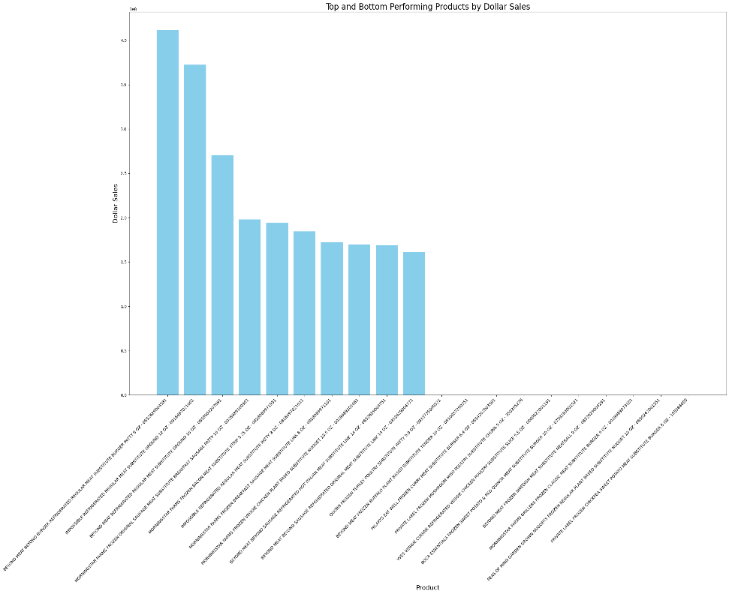
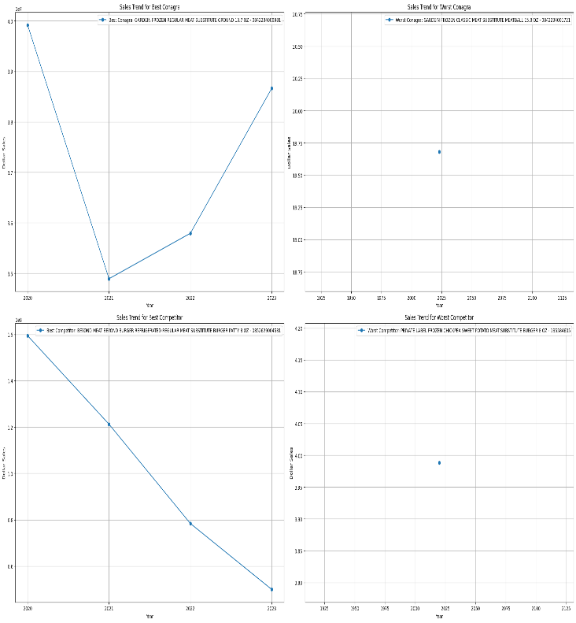
PREDICTIVE ANALYSIS
1: Does the discount impact the sales of high-performing products and low-performing products? (includes plots as well) Unique product names

Slide 10
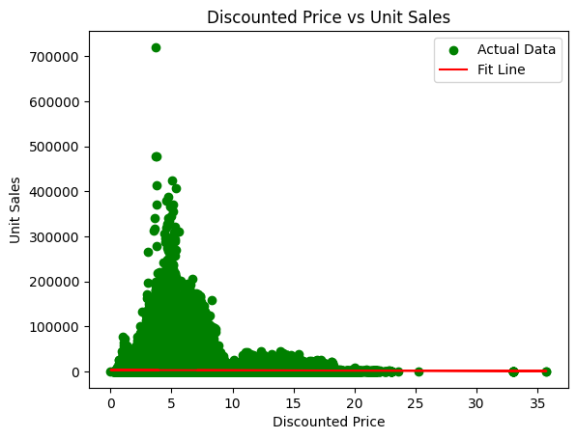
Analysis
Analysis indicates limited impact of discounted prices on overall sales volumes, with most activity occurring at lower price points, hinting at alternative drivers of sales beyond price.
While many products lack strong correlation between discounts and sales, select items like "GARDENBURGER FROZEN ORIGINAL MEAT SUBSTITUTE BURGER" exhibit significant sales spikes with discounts, highlighting the potential effectiveness of targeted discount strategies.
To enhance understanding of pricing dynamics, further exploration using non-linear models and consideration of additional variables like marketing efforts and consumer preferences is recommended.

Slide 11
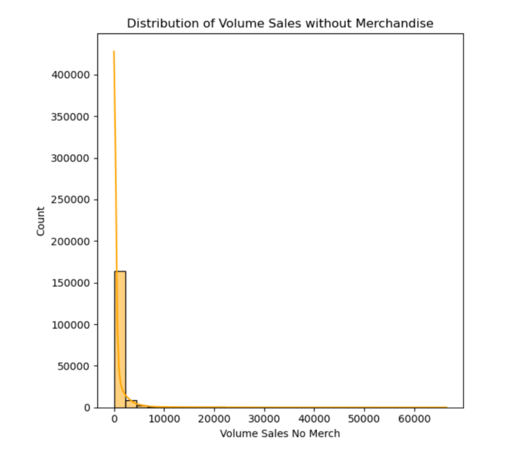
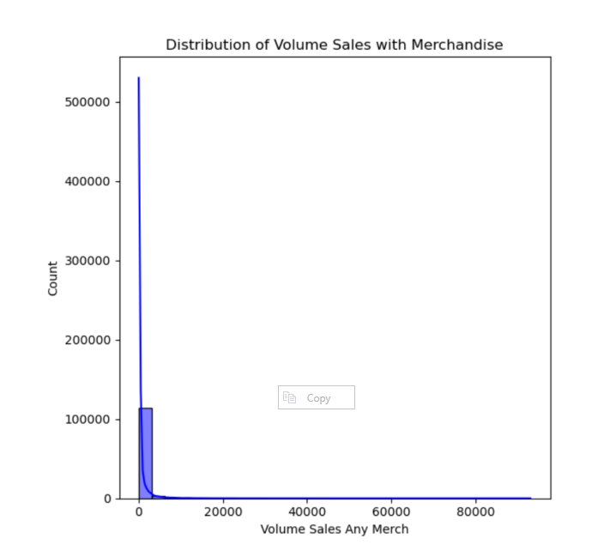
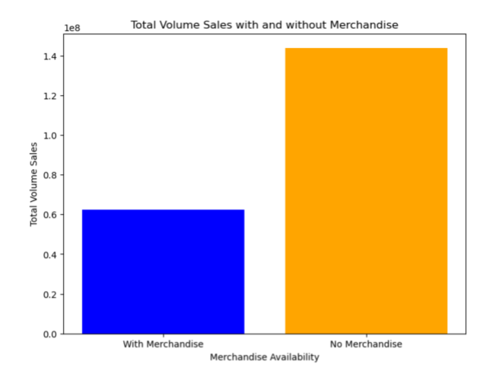
PREDICTIVE ANALYSIS
2: Does the volume sales with respect to merchandise versus no merchandise impact sales?

Slide 12
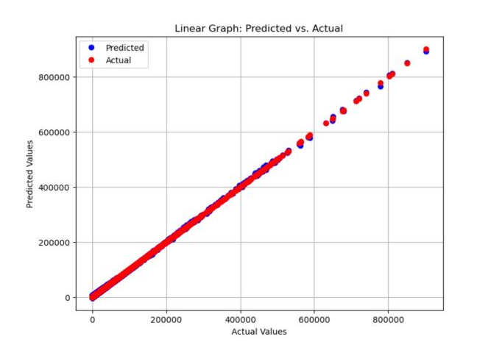
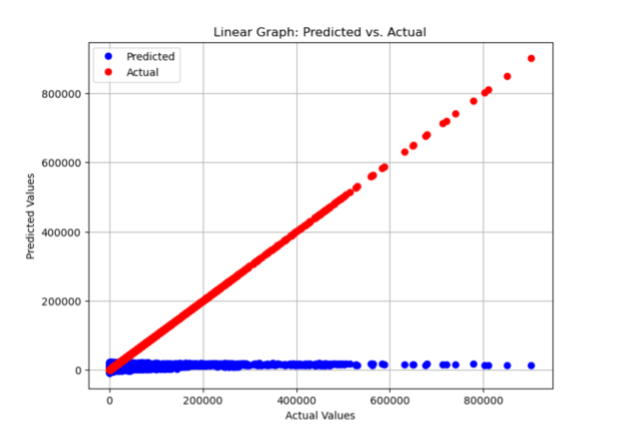
ANALYSIS
First Ridge Regression Model and its results:
Ridge Regression Mean Squared Error: 3725269.22577414
Ridge Regression R-squared: 0.9964240424752682
Adjusted R-squared: 0.9964231999145
New Model’s results and screenshots:
Mean Squared Error: 1018792514.3919865
R-squared: 0.022041485545673423
Adjusted R-squared: 0.02193514910583505

Slide 13
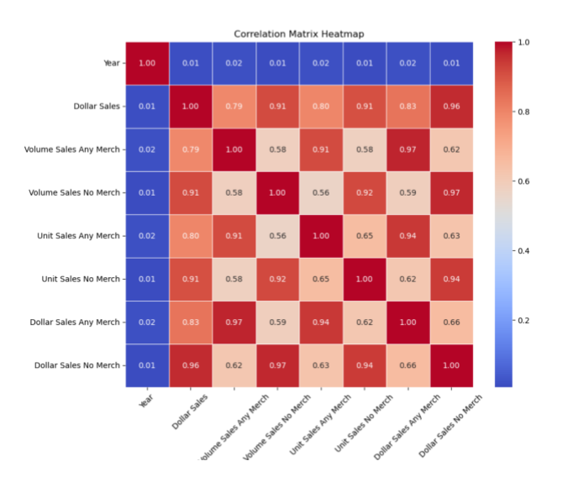
CORRELATION
Acknowledging the challenge of heavy overfitting highlighted by the R-squared value, efforts were made to address it by eliminating fields with correlation values surpassing 0.7. Unfortunately, this approach backfired, leading to a substantial decrease in the R-squared value and causing the model's predictions to deviate significantly from actual values.
"Unit Sales No Merch" and "Volume Sales No Merch" correlate strongly (0.97), indicating parallel increases.
Conversely, "Dollar Sales Any Merch" and "Dollar Sales No Merch" show a weak negative correlation (-0.2).
These findings illuminate intricate relationships between merchandise presence and sales metrics.

Slide 14
Recommendations
Merchandise Strategy: Reassessing merchandise strategy is crucial due to lower sales performance. Market research or customer surveys can unveil preferences, guiding adjustments for optimal alignment.
Promotional Strategies: Implement targeted promotions or discounts on merchandise to spur demand. Experimentation with diverse approaches aids in identifying the most effective strategies.
Inventory Management: Given lower merchandise sales, prudent inventory management is vital to avoid overstocking. Employing inventory optimization techniques ensures lean levels while meeting demand.
Customer Experience Enhancement: Despite merchandise sales challenges, prioritize enhancing overall shopping experiences. Investment in staff training, product presentation, and store ambiance fosters customer loyalty and repeat purchases.

Slide 15
Conclusion
Conagra's discount strategy needs refinement, with discounts benefiting less popular products but potentially harming profits for bestsellers. A more strategic approach to discounts, prioritizing high-quality products, is recommended. Merchandising efforts should be focused on high-profit items and enhancing the overall shopping experience rather than being relied upon solely to boost sales. Continuous market research and data-driven adjustments are essential for Conagra to maintain and expand its presence in the competitive meat substitutes market.

Slide 16
REFERENCES
https://www.datanovia.com/en/blog/types-of-clustering-methods-overview-and-quickstart-r-code/
https://www.scribbr.com/statistics/simple-linear-regression/
https://www.conagrabrands.com
https://www.marketsandmarkets.com/Market-Reports/meat-substitutes-market-979.html
https://en.wikipedia.org/wiki/List_of_Conagra_brands
https://www.fortunebusinessinsights.com/industry-reports/meat-substitutes-market-100239#
https://www.grandviewresearch.com/press-release/global-meat-substitutes-market

Slide 17
THANK YOU

